Slide 1

INNOVATIoN AND ENTREPRENEURSHIP
Sessions Contd.
Satish Medapati

Slide 2
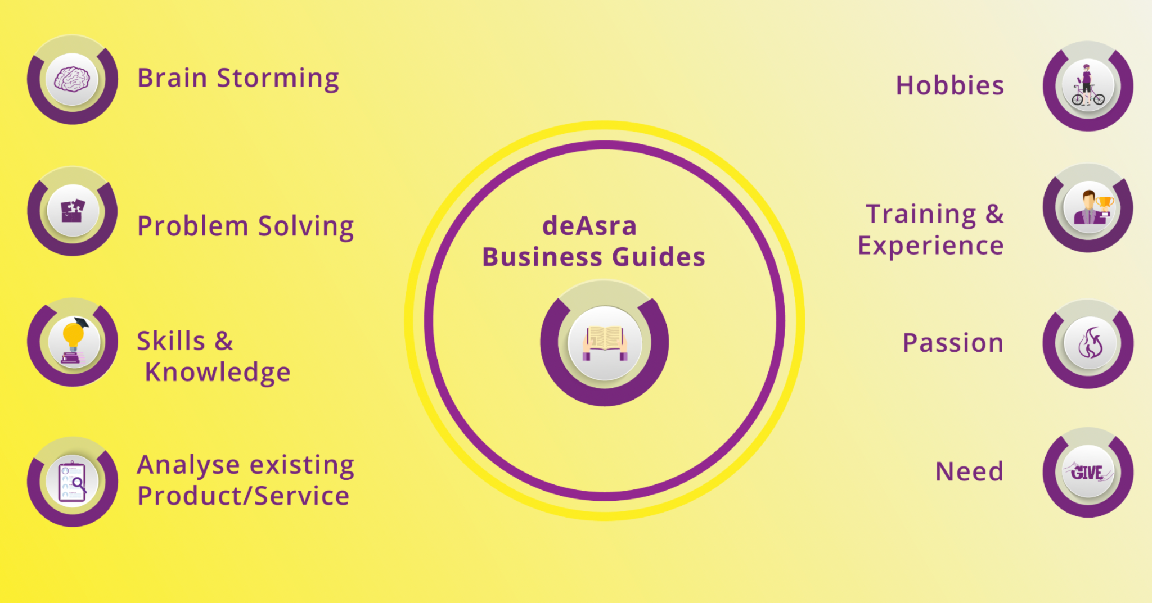

Slide 3
HOW TO PLAN FOR A BUSINESS
WHERE TO START ONCE YOU HAVE MAPPED OUT THE PRODUCT
HOW TO LEVERAGE EXPERIMENTS
HOW TO ALIGN BUSINESS GOALS
PRODUCT MARKET FIT

Slide 4
Brainstorming may seem to lack constraints, but everyone must observe eight house rules and have someone acting as facilitator. (Source: https://www.interaction-design.org/)
Set a time limit – Depending on the problem’s complexity, 15–60 minutes is normal.
Begin with a target problem/brief – Members should approach this sharply defined question, plan or goal and stay on topic.
Refrain from judgment/criticism – No-one should be negative (including via body language) about any idea.
Encourage weird and wacky ideas – Further to the ban on killer phrases like “too expensive”, keep the floodgates open so everyone feels free to blurt out ideas (provided they’re on topic).
Aim for quantity – Remember, “quantity breeds quality”. The sifting-and-sorting process comes later.
Build on others’ ideas – It’s a process of association where members expand on others’ notions and reach new insights, allowing these ideas to trigger their own. Say “and”—rather than discourage with “but”—to get ideas closer to the problem.
Stay visual – Diagrams and Post-Its help bring ideas to life and help others see things in different ways.
Allow one conversation at a time – To arrive at concrete results, it’s essential to keep on track this way and show respect for everyone’s ideas.

Slide 9
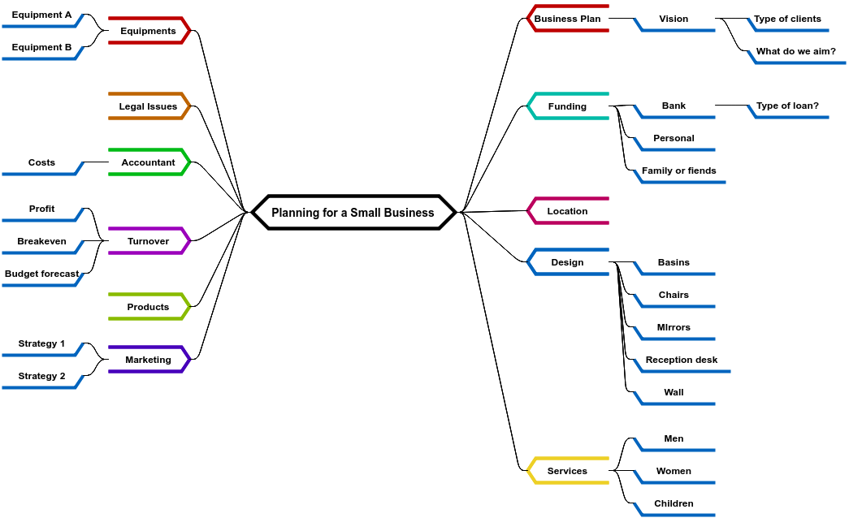
MIND MAP OF BUSINESS LANDSCAPE

Slide 10
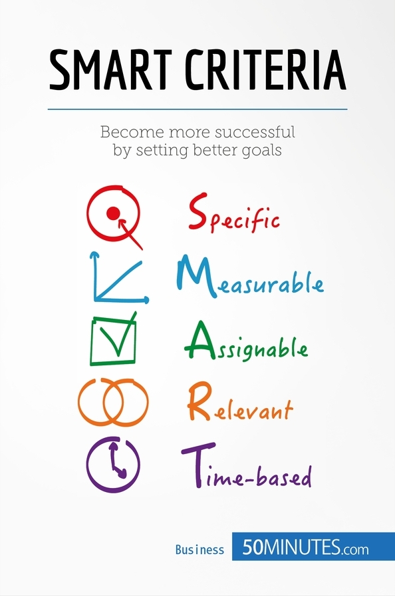
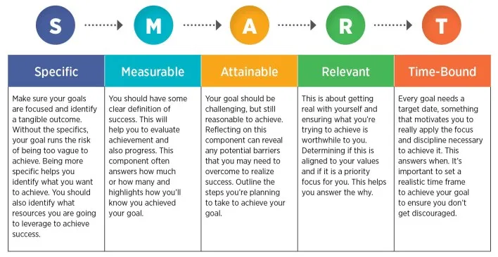
How do we set out goals ? SMART framework

Slide 11
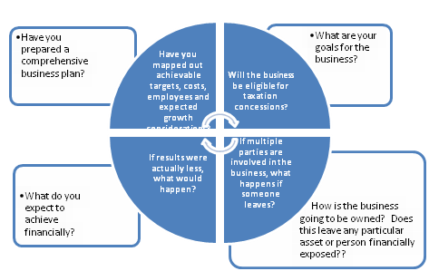
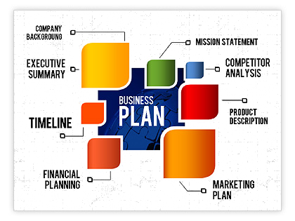
BUSINESS PLANNING
Research, research, research.
Determine the purpose of your plan. ...
Create a company profile. ...
Document all aspects of your business. ...
Have a strategic marketing plan in place. ...
Make it adaptable based on your audience. ...

Slide 12
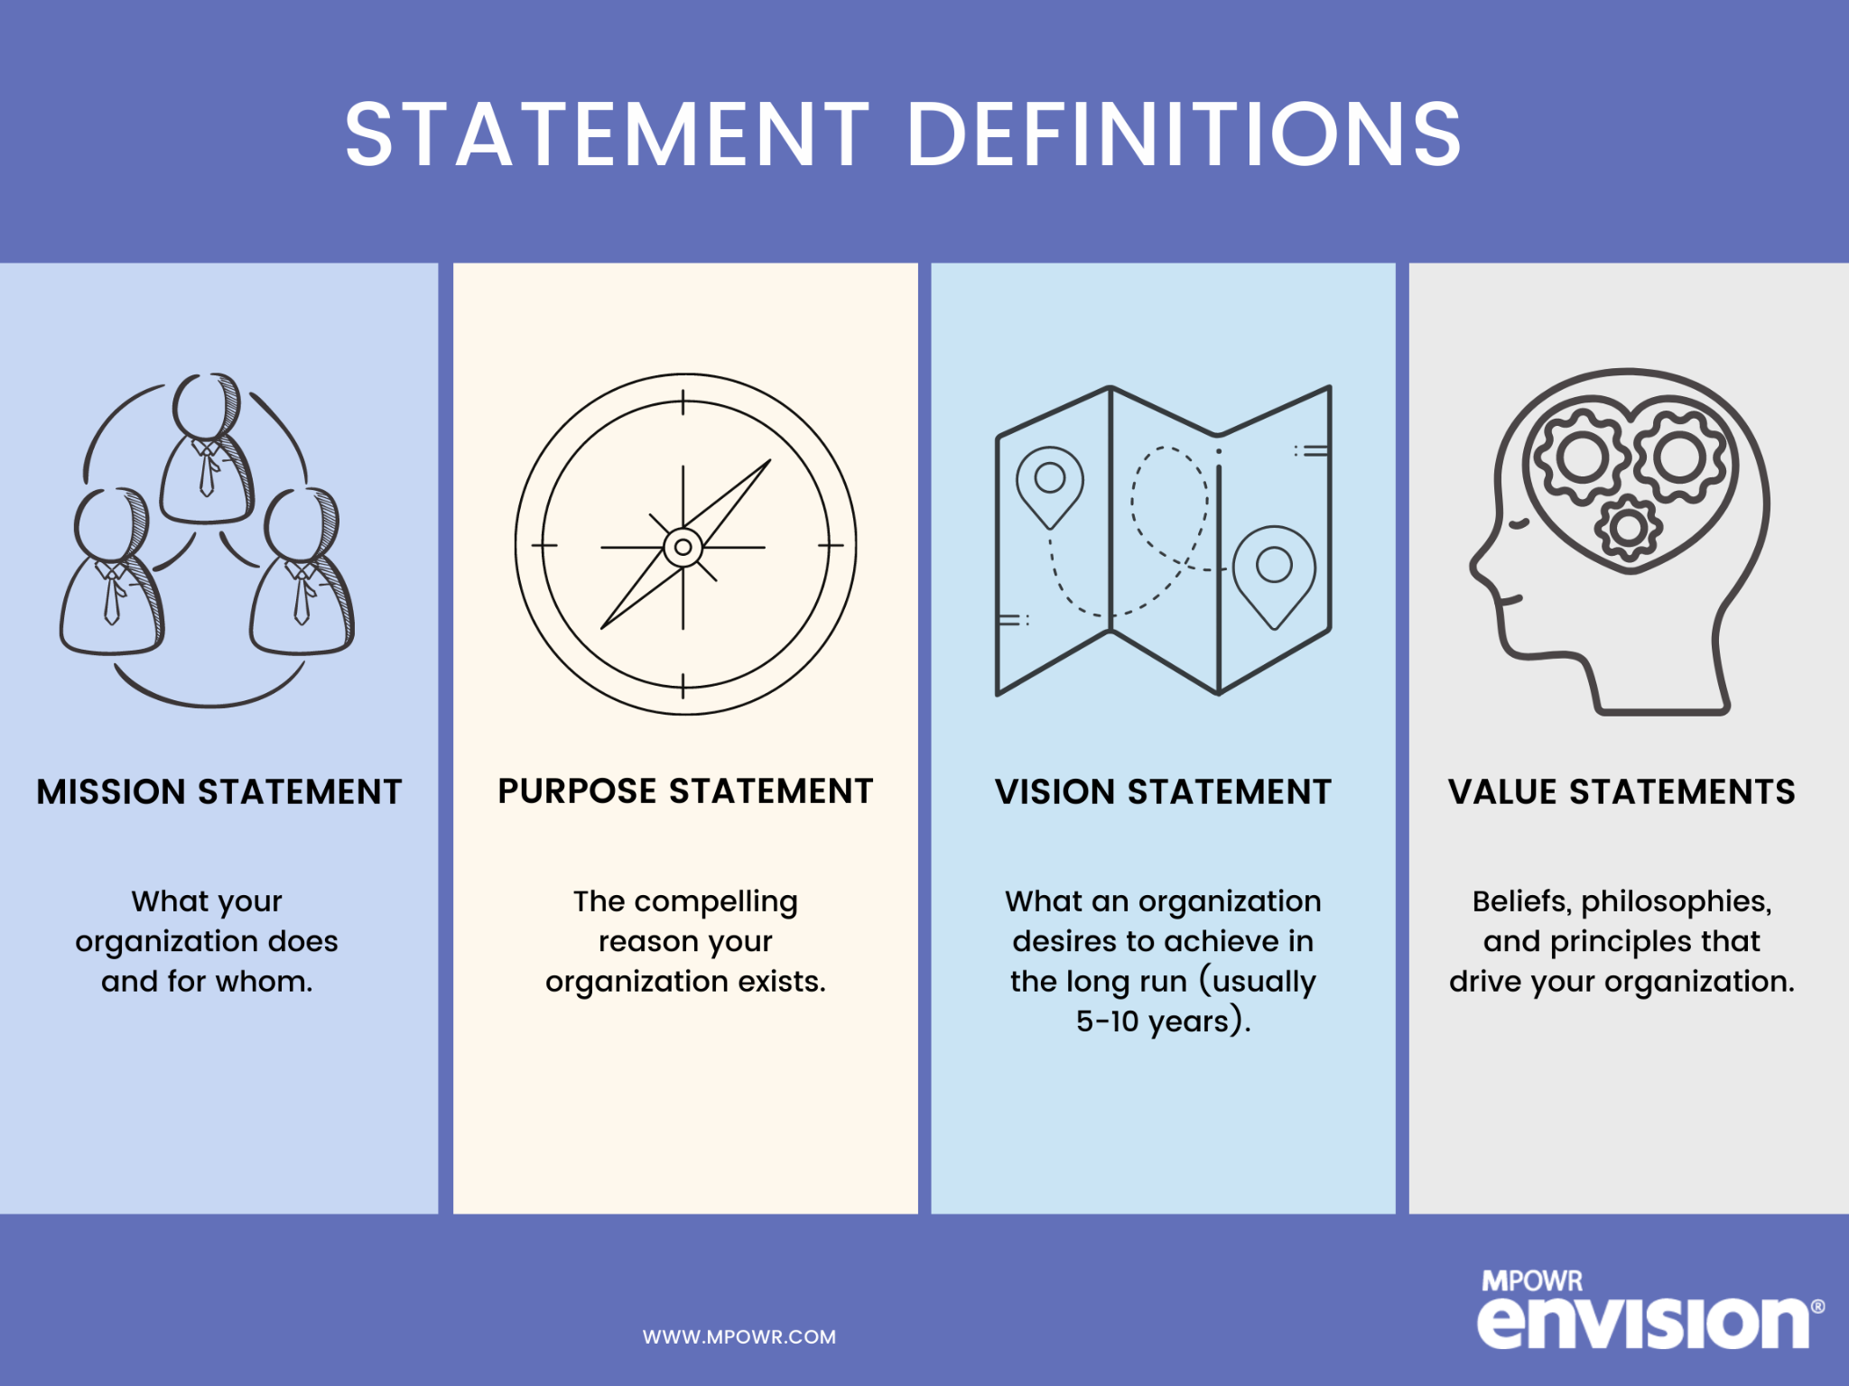

Slide 13
Business Planning Stage: Playbook
Summary (Business vs. Revenue Model)
Corporate Structure
Big Picture Goals
Market Sizing
Human Capital & Costs
Revenue Planning (Short Cycles)
Unit Economics
GTM Templates (covering in Depth)
Cap Table Management (Venture hacks)
Technology Assessment
Competitive Assessment

Slide 14
Gaining Initial Traction

Slide 15

GETTING
YOUR FIRST
CUSTOMER
First KNOW who you are selling to and what problems you are solving for them
1.Use Relationships you have
2. List Builds
3.Stalk & Talk
4. Partnerships
5. Expertise
6. Content, Social
Getting your FIRST Customer !
Manufacturing:
Technology
Services

Slide 16
Initial Traction
1. Walking in to corporate offices to see what they needed - understand client requirement first ?
2. Creating mock screens and asking clients if they will pay , than investing lot of money to build and then fail
3. Exploring all cost cutting options - free server , subsidised govt incubators like nasscom, leverage networks to refer clients free , take consultants on project basis for non core activities
B2B Product
1. Research on needs and problem that you are solving. Come out with an MVP
2. Get the first 100 users and research extensively on their behavioral patterns (what do they do, what do they not do)
3. Build feature set but be fluid with the same (Product Creep)
4. Grow through customer referrals and rewards
5. Product Market Fit
B2C Consumer
1. You already know the gap in the market, opportunity size and the skillsets required for undertaking a task
2. Sell services for the market with optimum PRICING and cost arbitrage
3. Manage people vs. project vs bench strength with thorough Cashflow management
4. Go after X% GP margins
B2B Services
1. Identify a niche segment that has a product or a cost arbitrage (Definitive expertise required)
2. Sell services for the market with optimum PRICING
3. Quality , Agility and SCM
B2B Manufacturing

Slide 17
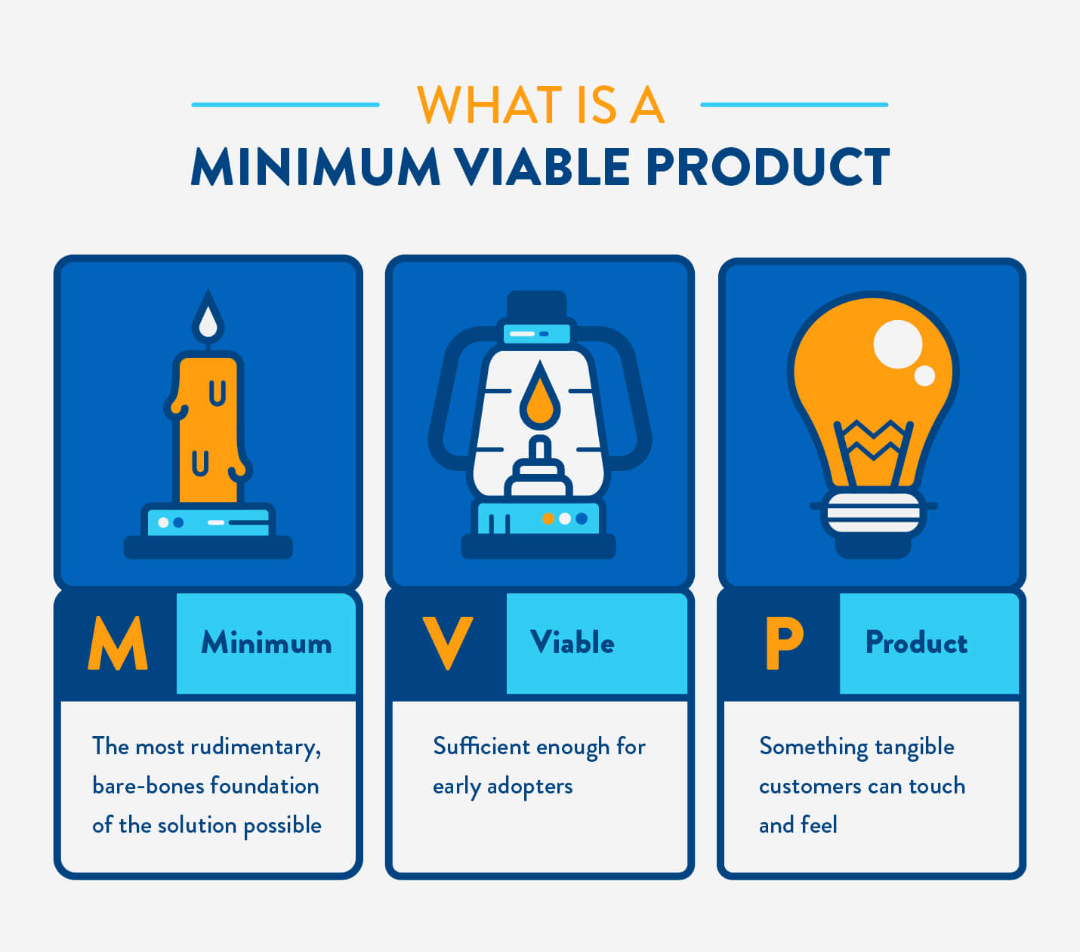
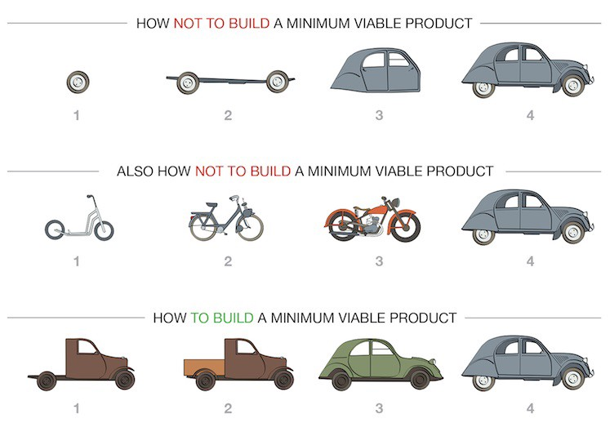
Minimum Viable Product

Slide 18
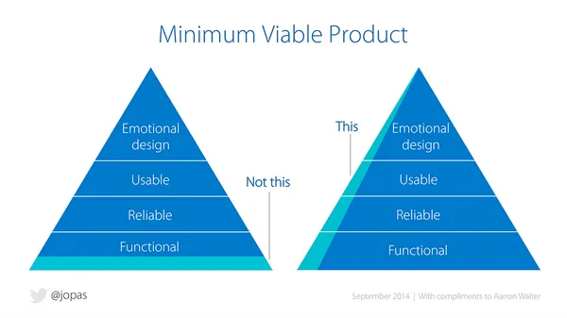

Slide 19
Conceptual Short Case
Ram and Shiv are friends.They both were classmates at IIIT Sricity and got into good IT jobs after their coursework in 2017. Both of them were made to take semi-paid leave during Covid’19 for 6 months. Ram worked at a healthcare major as an IT consultant and Shiv was in a robotics firm. As they have now lot of free time, they both decided separately to start their own companies.
Ram started realizing that there were gaps in the process in the job what we was doing . He thought he can do a healthcare privacy layer on top of databases but did not know where to start. He was sure that he would need to be compliant to Government rules but again did not know what to do. He felt that there is a great need for this security layer and he can become an entrepreneur. He started coding it right away and now in a month, he was already at a decent place in terms of building the product. He thought he can gain traction by selling it to B2B enterprises.
Shiv was in robotics and their firm was developing delivery drones. However, Shiv felt this market is very competitive. He had an idea of developing autonomous tractors for the farm sector but wasn’t sure. He was brought up in a village and hence was always sure that he would go back to his village and help the agricultural community. He has been working on putting together the business aspects for over a month now and still doesn’t seem to know where to start or where to end.

Slide 20
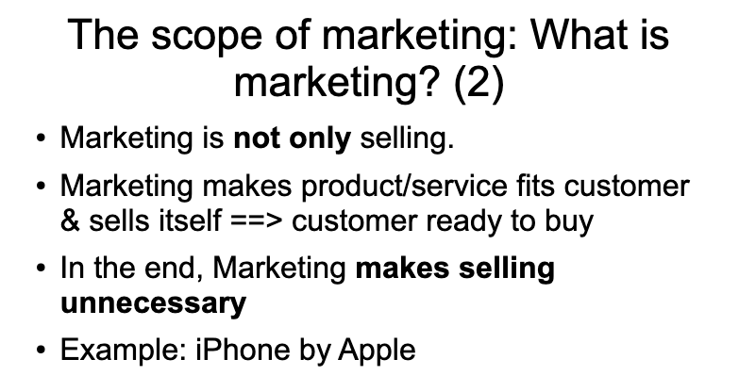
MARKETING MANAGEMENT - GOING THE TRADITIONAL ROUTE

Slide 21
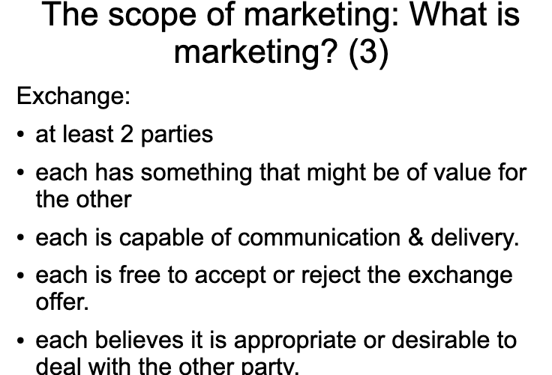

Slide 22
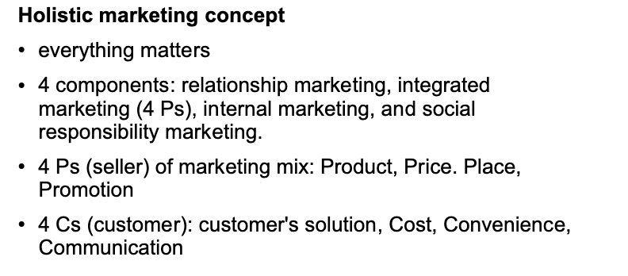
COMPLETELY CHANGED CONCEPT FROM ...

Slide 23
MARKETING MANAGEMENT - TRADITIONAL - NOW
DEFINITION - EXCHANGE
FEATURES
TARGET MARKET DEFINITION
NEW PRODUCT DEVELOPMENT
PRODUCT LIFE CYCLE
STP
MARKETING STRATEGY
PRICING
PROMOTION
SALES
ADVERTISEMENTS
CONSUMER BUYING BEHAVIOUR
MARKET MIX MODELING
DESIGN THINKING
MVP (MINIMUM VIABLE PRODUCT)
PRODUCT MARKET FIT
DIGITAL MARKETING (TECH)
GTM (GOTO MARKET STRATEGY)
MARKETING STRATEGY
(PROMOS, SALES, ADS?)

Slide 24
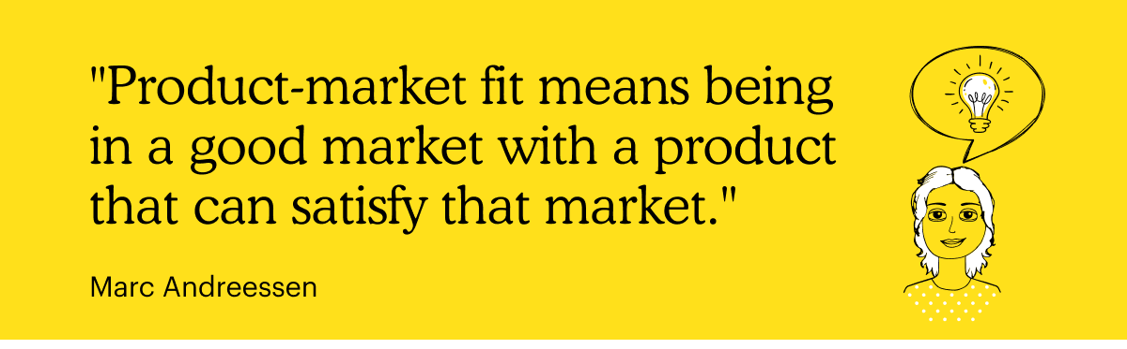

Slide 25
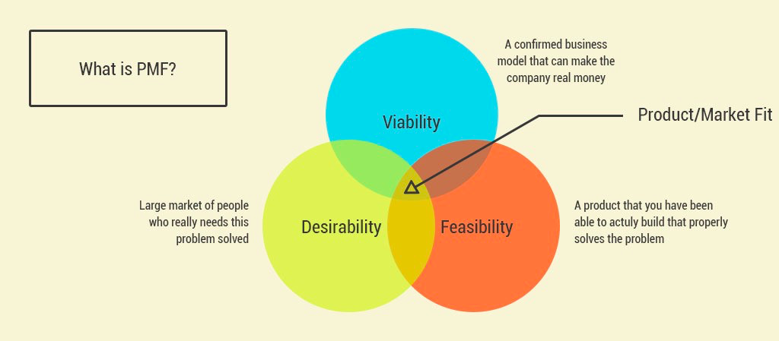
Addressing PMF (Product Market Fit)

Slide 26
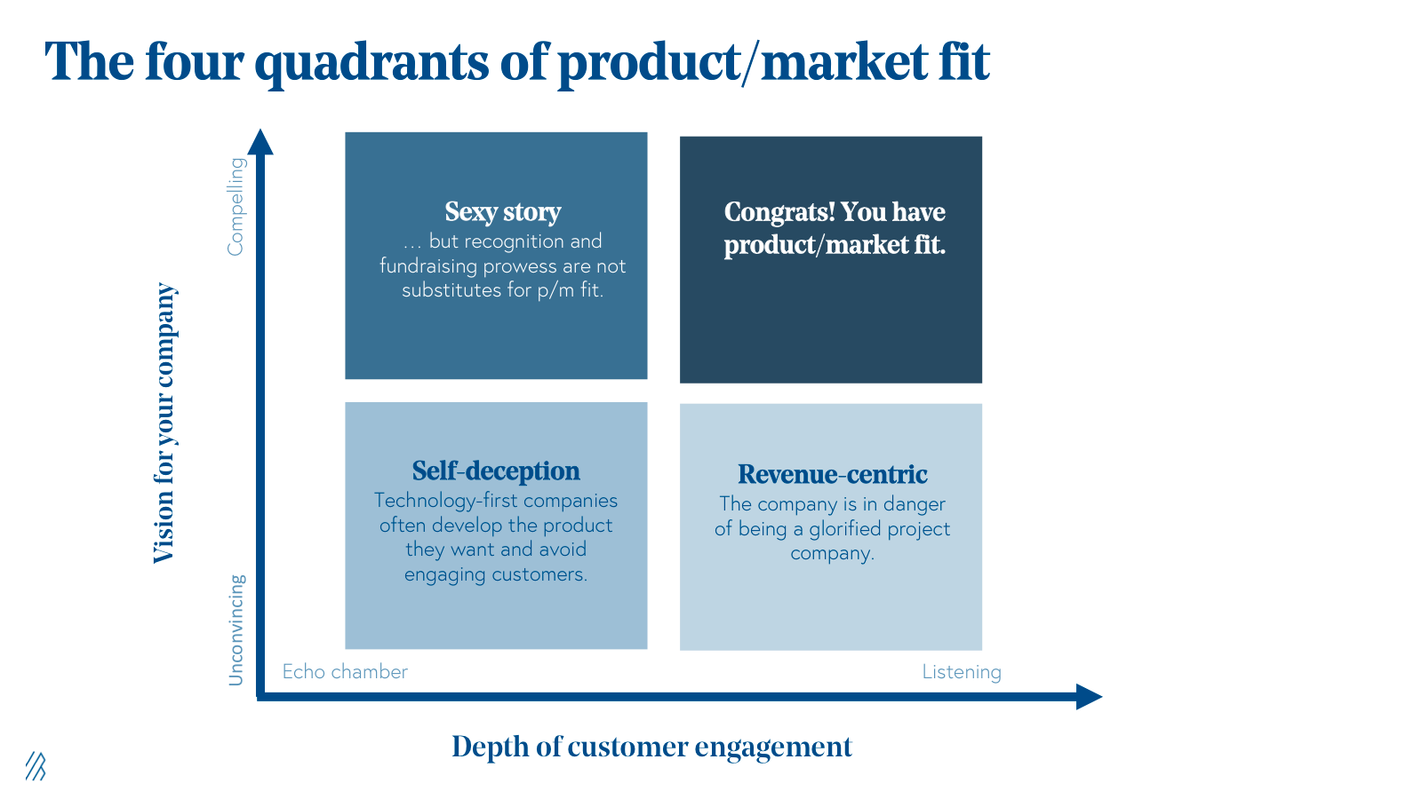
PMF Matrix

Slide 27
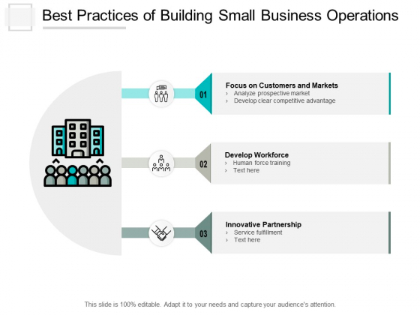
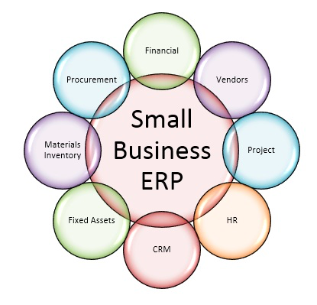
Managing Operations
INTERNAL/EMPLOYEE:
CRM
EMPLOYEE MANAGEMENT
PROJECT MANAGEMENT
COMMUNICATION CHANNELS
TRACKING WORK
CLIENT COMMUNICATION:
PROFESSIONAL EMAIL
PROJECT MANAGEMENT
DOCUMENT TEMPLATES

Slide 28

SWOT
Marketing Plan
Marketing Mix
Product Market Fit
Financial Management
Growth
You know your customers!
You know your product
What Next ?

Slide 29
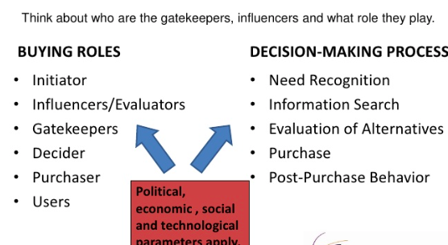
Who is your Customer and Where is He/She?
Where is He/She? How to Target:
Association Events
Chamber Events
Clubs/Social Spaces (Post Covid?)
Social Media
Trade Shows
Business Publications
Webinars
Seminars
Industry Associations
Research
Primary Research
Secondary Research

Slide 30
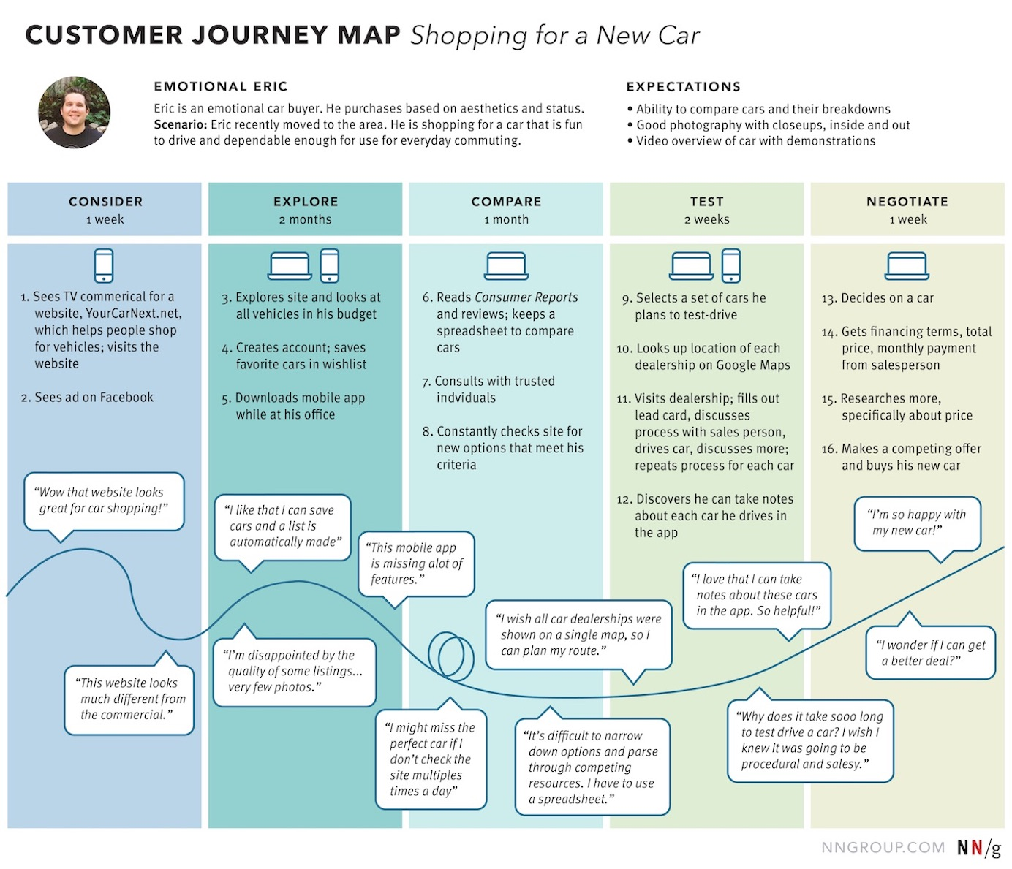
Customer Journey Map Example

Slide 31
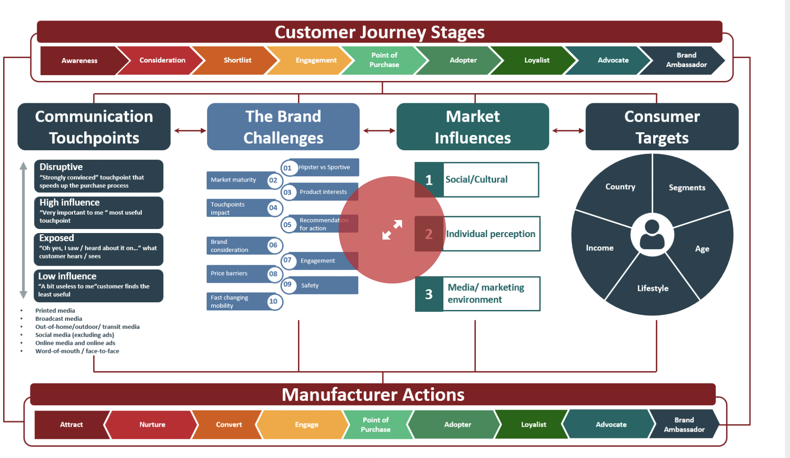
Who is your Customer and Where is He/She?
Source: ADK

Slide 32
Your marketing plan is your strategy of allocating resources (time, money, effort, focus) in order to reach your goal

Slide 33
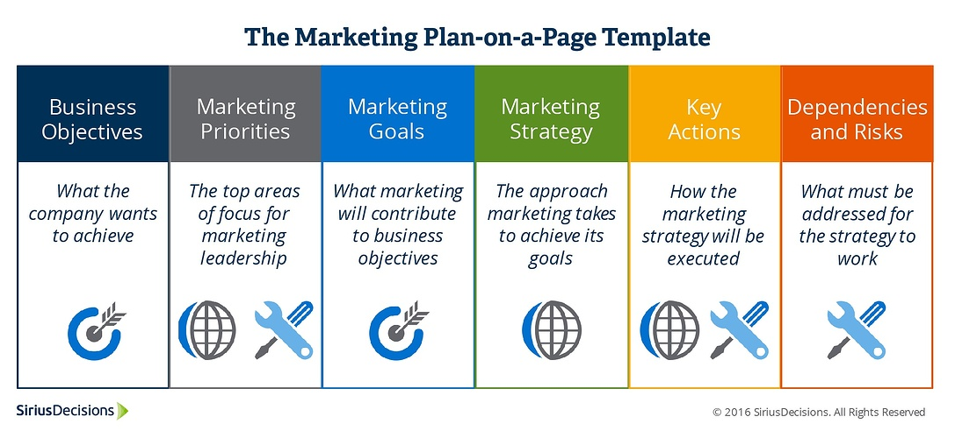
Notes:
https://www.bizible.com/blog/strategic-marketing-plan

Slide 34
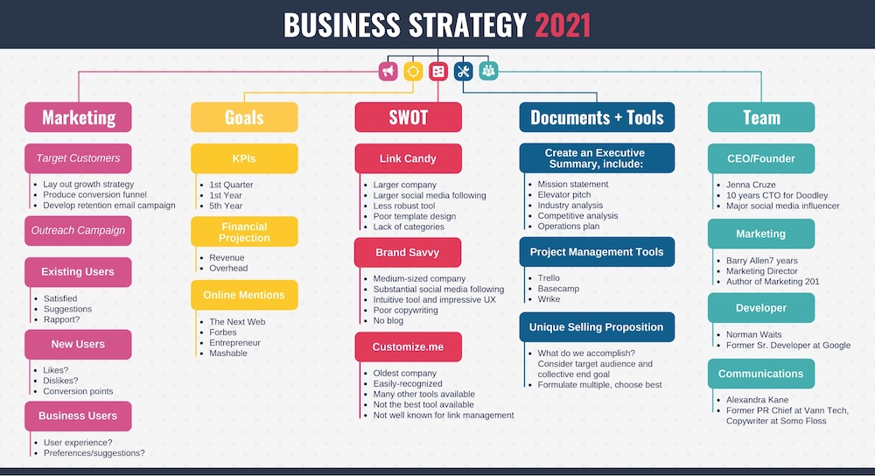

Slide 35
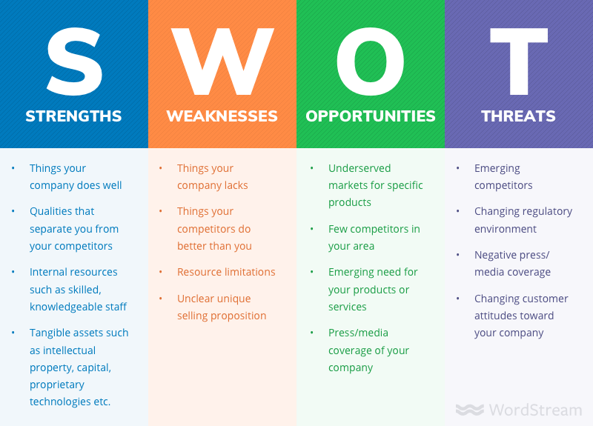

Slide 36
GO-TO-MARKET STRATEGY
Goals in the year
Whom to sell ?
Marketing Strategies
Partnership Strategies
Channel Partners
Pricing
Metrics and Measurement
Definition:
A go-to-market strategy (GTM) is the plan for targeting the right pain point with the right sales and marketing process, so you can grow your business at the optimum pace. You can create a GTM strategy for a new business but also for a new feature, brand or location.

Slide 37
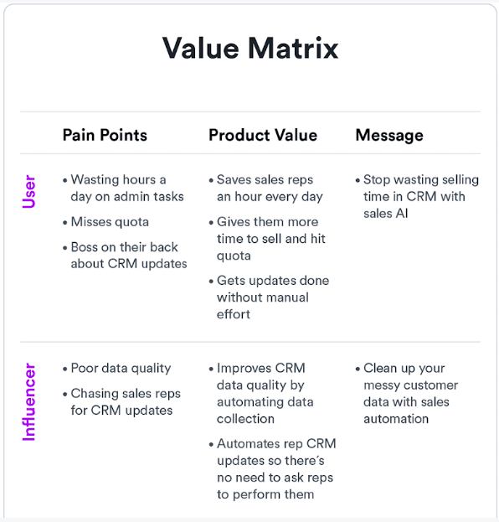
Value Matrix and messaging around the pain point: This is a good way to understand what the pain point is and how to set up messaging to address the pain point.

Slide 38
GO-TO-MARKET STRATEGY
Choose a marketing strategy: This is where you figure out your inbound and outbound strategies (content, email, outreach etc)
Choose a sales strategy: You might use only one or a mix of self service where they enter credit card and buy, inside sales, heavy duty field sales or a channel model.
Sales is when you're face-to-face with a customer, convincing a person to buy your product while Marketing is the collection of decisions you make about the market that leads to successful sales. Marketing is the planning part of sales.

Slide 39
How do l pick the right benefits, headline and messaging for my GTM?
Use the positioning process and the strategic sales narrative
Al Ries definition: “Positioning is not what you do to the product; it’s what you do to the mind of the prospect. It’s how you differentiate your brand in the mind. Positioning compensates for our over-communicated society by using an oversimplified message to cut through the clutter and get into the mind. Positioning focuses on the perceptions of the prospect not on the reality of the brand.“

Slide 40

Positioning Examples

Slide 41
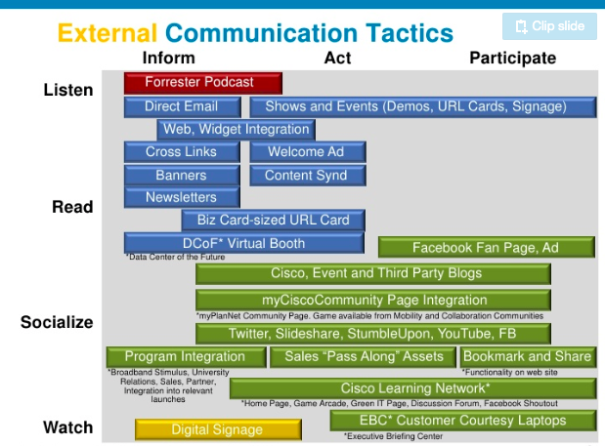
Cisco’s GTM for a learning game

Slide 42
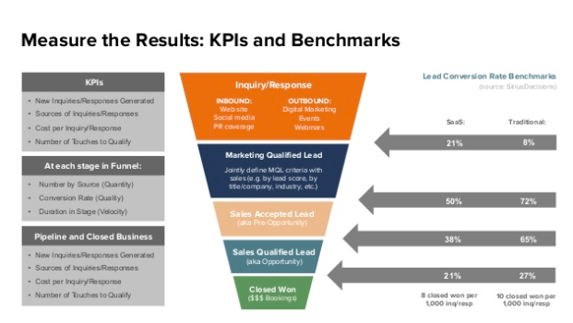
Notes:
Source: a16Z

Slide 43
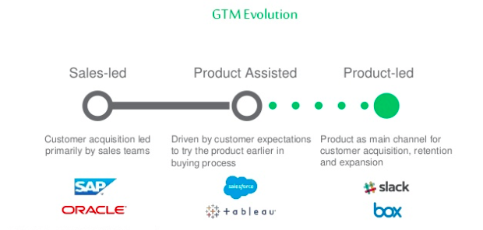
Product led GTM for Technology Companies

Slide 44
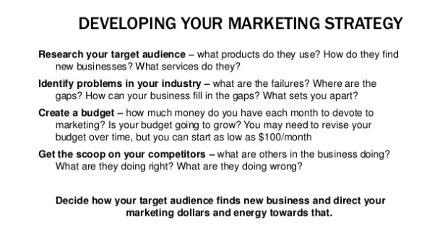
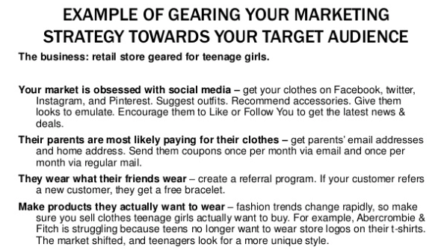
Developing your Marketing Strategy

Slide 45
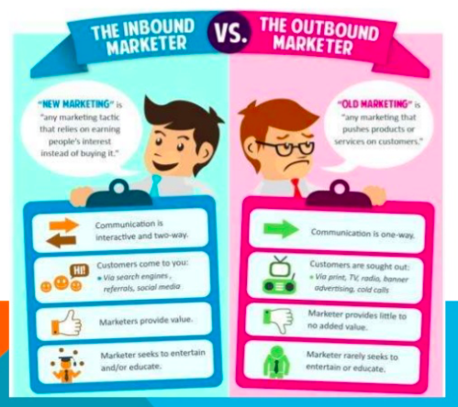
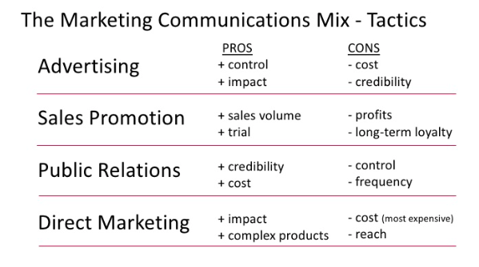
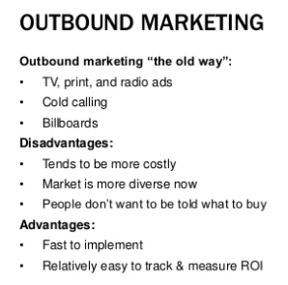
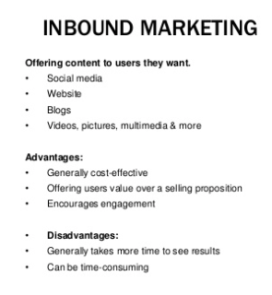
Marketing Communications Mix

Slide 46
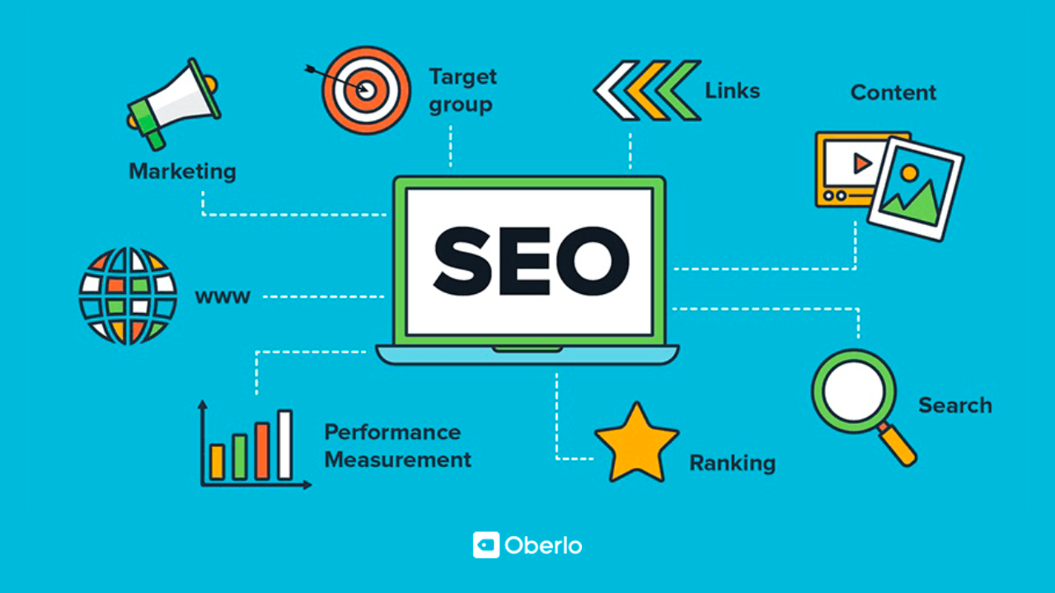
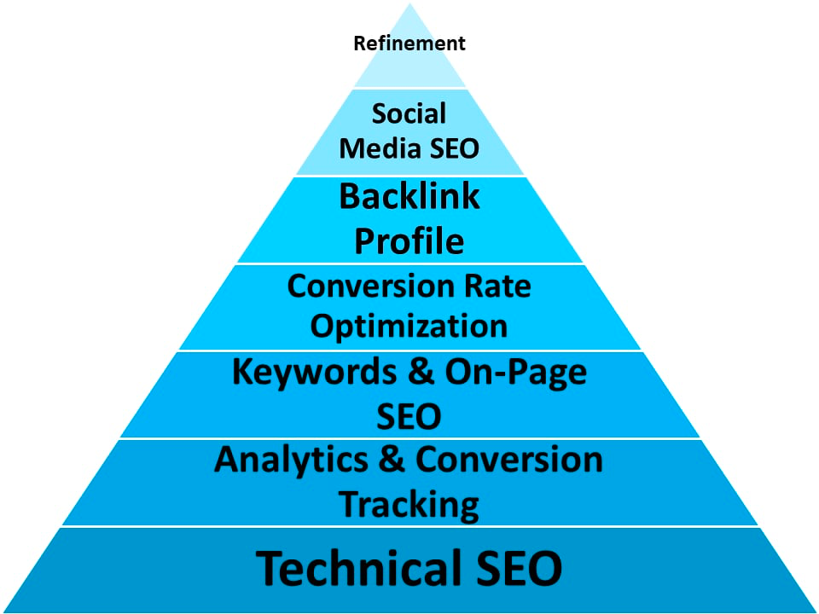
Digital Marketing Concepts

Slide 47
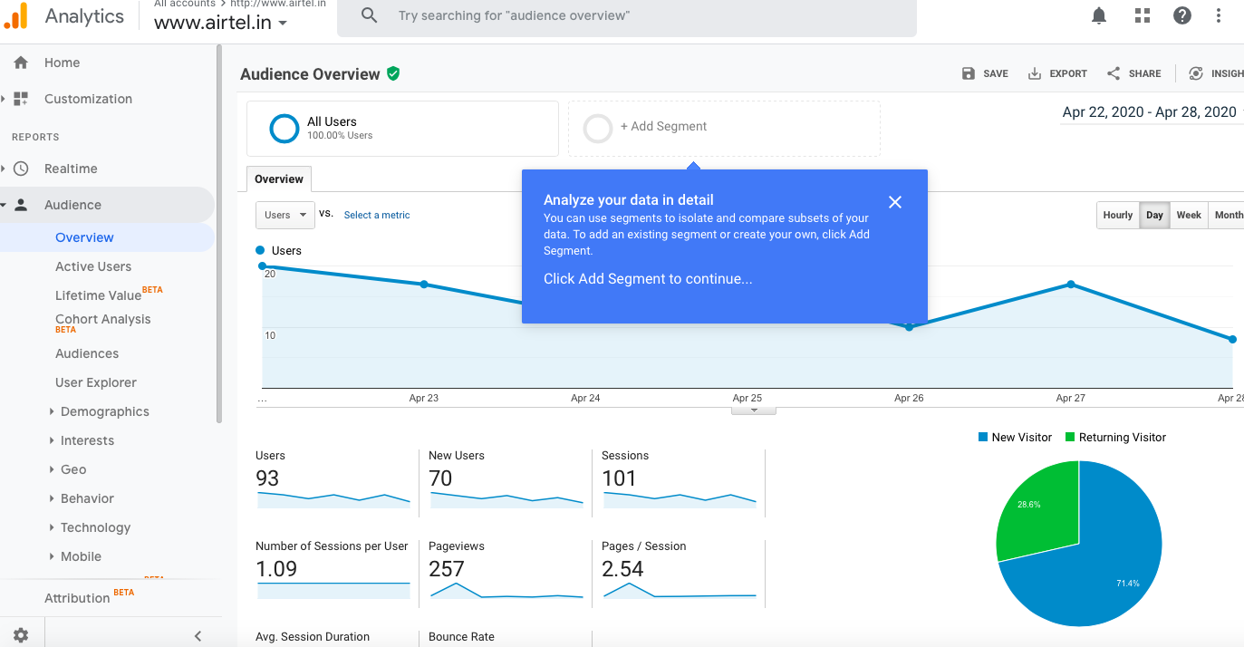
Setting up Google Analytics

Slide 48
Digital Marketing Concepts
Website
Newsletter , Blog
SEO/SEM
Setting up Social Media accounts
Building your following in Social Media
Blogging / Quora
Online Listing (G+/Bing)
Email Campaigns

Slide 49
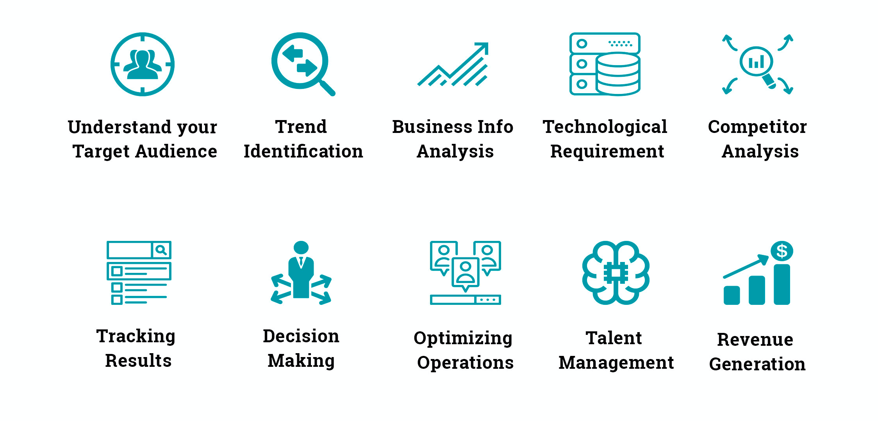
In a Nutshell.. Business Management

Slide 50
FINANCIAL MANAGEMENT
TEMPLATES

Slide 51
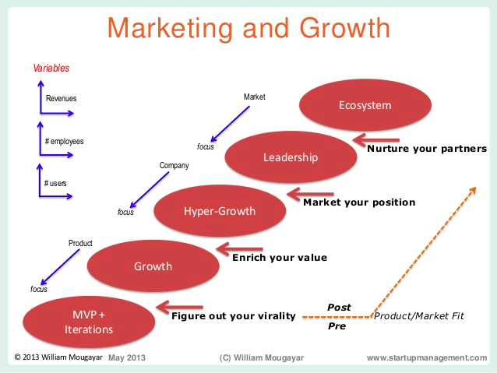
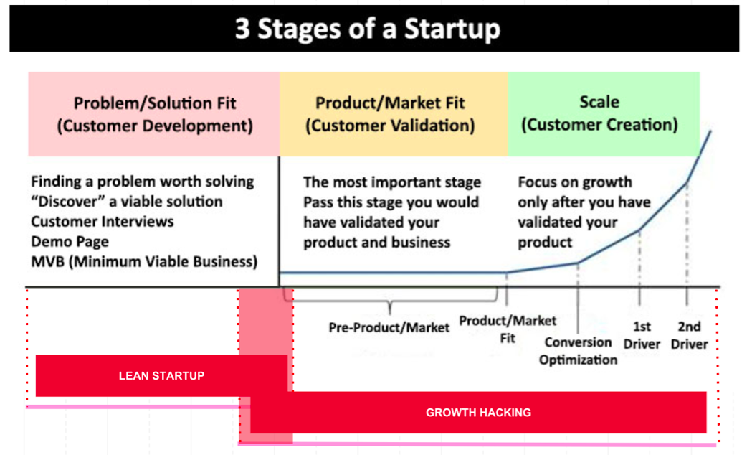
Journey from a Start up to an Enterprise

Slide 52
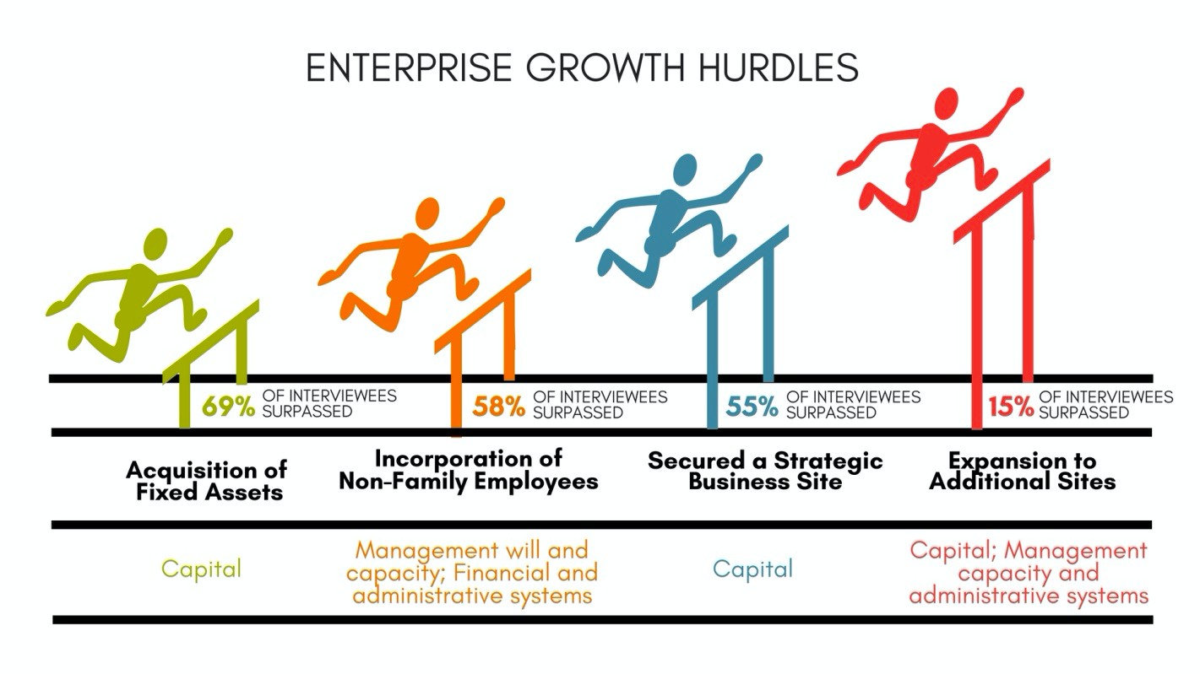

Slide 53
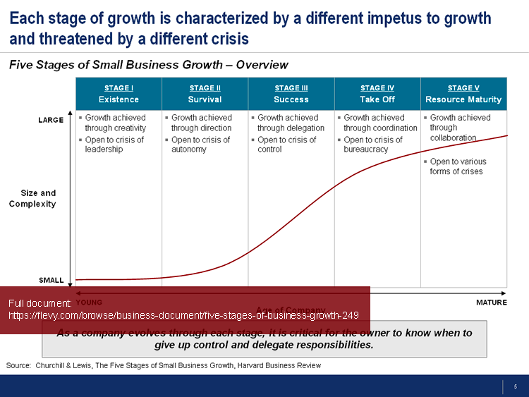
Growth Stage

Slide 54
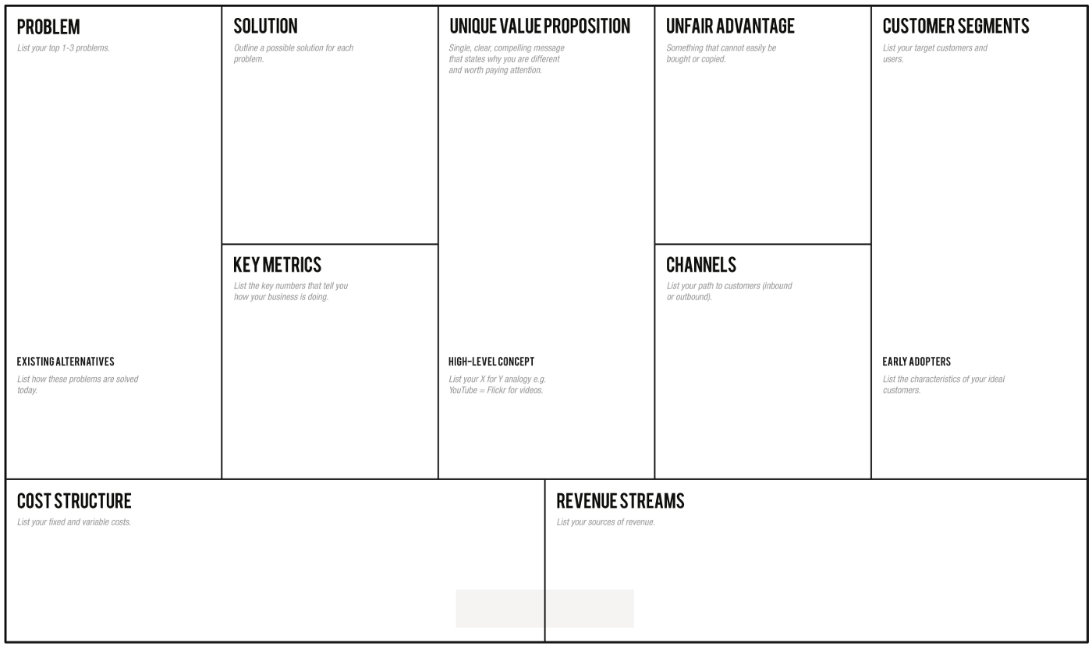
Product Market Fit - Contd.

Slide 55
Referral Websites
https://www.impactplus.com/blog/product-market-fit
https://medium.com/radikal-studio/pmf-framework-5-steps-to-product-market-fit-2021-4c95a0c964ad
Pitch Deck Template:
https://guykawasaki.com/the-only-10-slides-you-need-in-your-pitch/
https://venturehacks.com/
Customer Journey Map
https://www.nngroup.com/articles/analyze-customer-journey-map/
Competition:
https://www.kickframe.com/blog/2018/9/5/mapping-your-competitive-brand-position

Slide 56
THANK YOU

Slide 57
BEFORE YOU GO!

